Slide 1
HLR: DV Env for PLIC
Presenter: Muhammad Hassan
Tech Lead: Hassan Raza
Date: 12 Sep, 2023

Slide 2
TCP Overview

Slide 3
TCP Description
PLIC connects global interrupt sources, which are usually I/O devices, to interrupt targets:
Global interrupts from various sources are processed by an interrupt gateway, which send them into a single interrupt request for the PLIC core. The core manages interrupt priorities, enabling specific interrupts for each target. When enabled interrupts have priority greater than threshold, the core notifies targets to claim and service the highest-priority interrupt, clearing the pending bit. After servicing, the interrupt gateway can forward additional requests for the same source to the PLIC.

Slide 4
TCP Steps/Milestones
1- Make interfaces for both AHB bus and Interrupt sender.
2- Make environment that contains separate agents for both AHB BUS and Interrupt.
3- Make virtual sequencer and sequence to control both agent’s sequences in parallel
4- Write a test class and testbench module to run these sequences on DUT.
5- Write Test Plan and select particular tests to be tested.
6- Make scoreboard in Environment and join needed ports to it.

Slide 5
TCP Timeline
MILESTONE | Expected Date | Actual Date
Make interfaces for both AHB bus and Interrupt sender | 15th August | 15th August
Make environment that contains separate agents for both AHB BUS and Interrupt | 21th August | 21th August
Make virtual sequencer and sequence to control both agent’s sequences in parallel | 24th August | 24th August
Write a test class and testbench module to run these sequences on DUT | 25th August | 25th August
Write Test Plan and select particular tests to be tested | 28th August | 28th August
Make scoreboard in Environment and join needed ports to it | 8th September | 11th September

Slide 6
Technical Overview

Slide 7
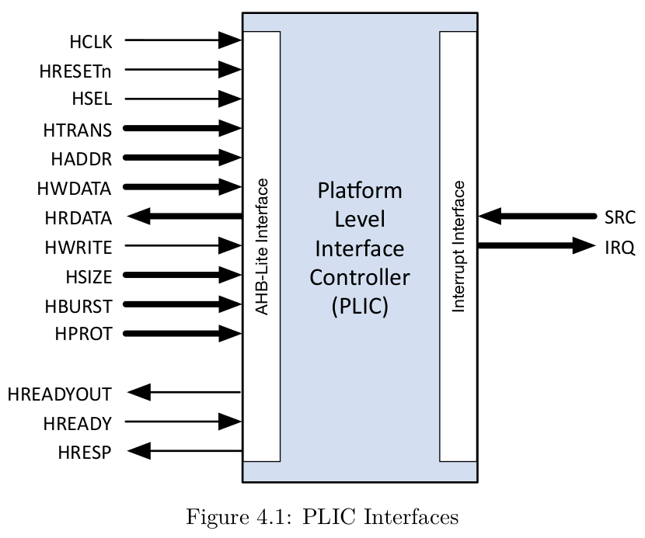
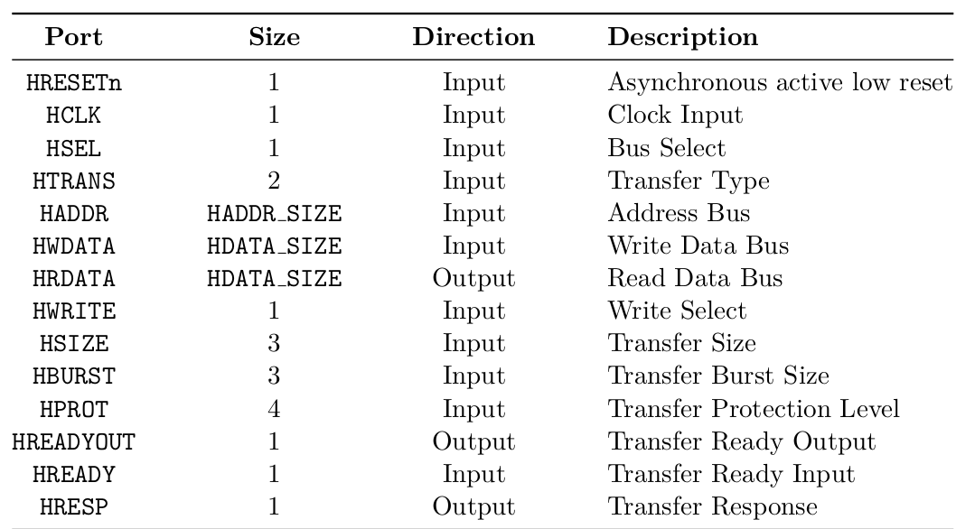
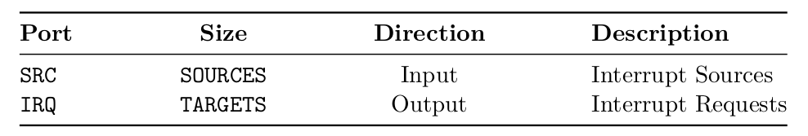
Design Under Test (DUT)

Slide 8
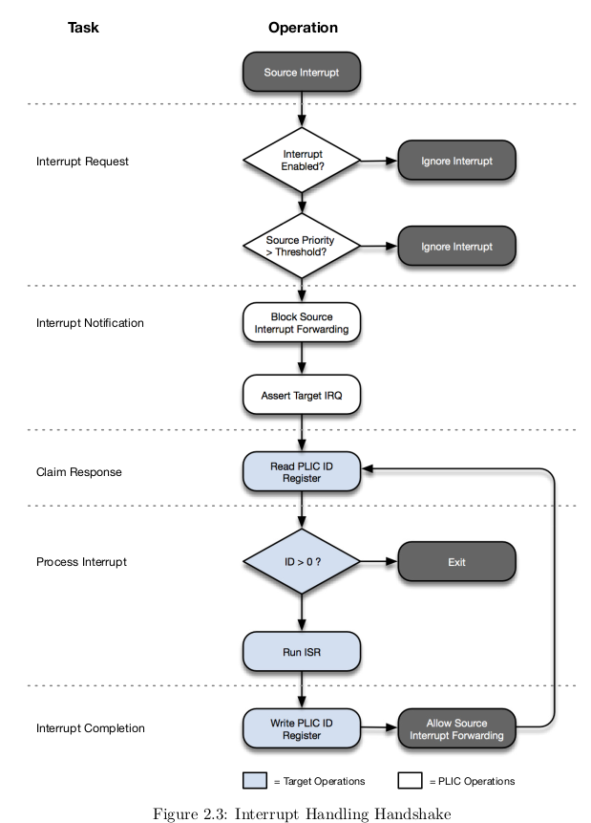
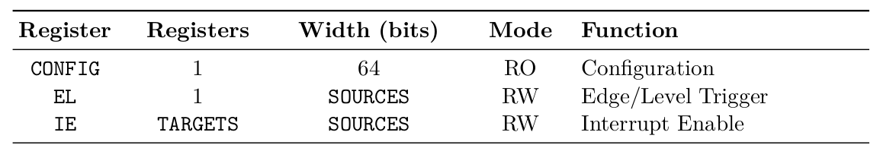
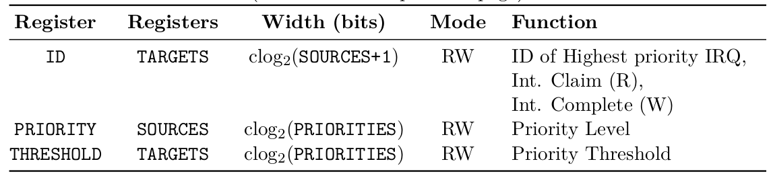
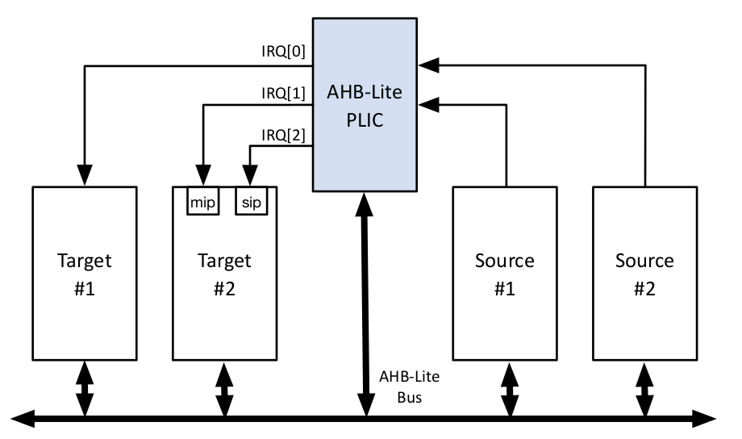
Design Under Test (DUT)

Slide 9
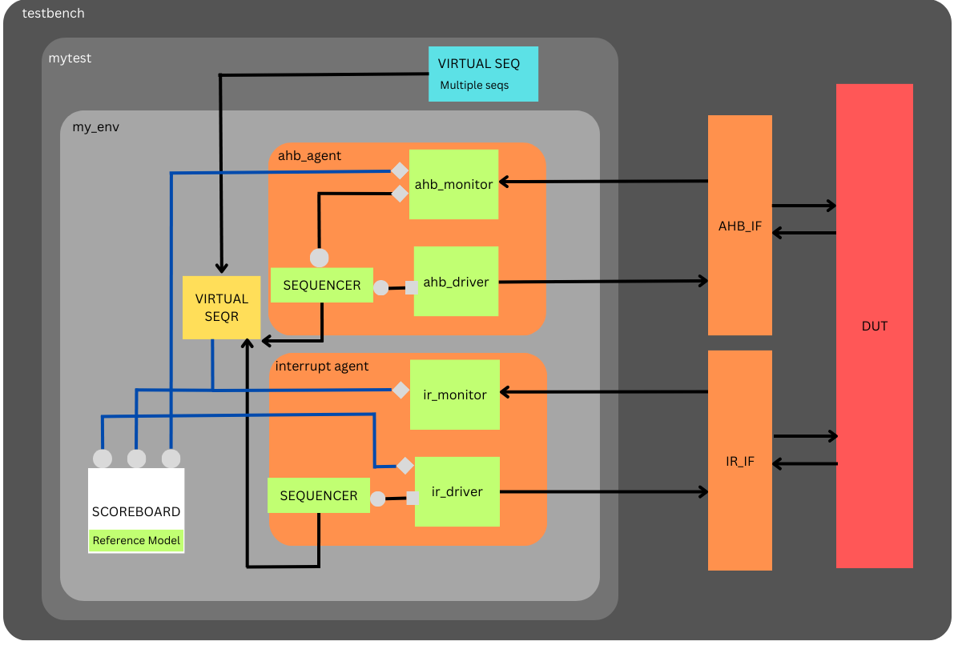
Block Diagram

Slide 10
Verification approach
Made two agents to handle both interfaces separately.
Made one environment that contain both agents, scoreboard and virtual sequencer.
Connected all sequencer with virtual sequencer to run independently sequences of our choice.
First of all reset the AHB bus and interface signals than configure PLIC registers using AHB bus and then start interrupt. PLIC validates required register and then asserts the selected target. After claim and complete registers notify PLIC that interrupt is served.
In Scoreboard get data from both monitors and interrupt driver and check two things first if the data is correctly written through AHB and second if all registers are configured correctly and then if interrupt comes it must be served by target and completed by claim and complete.

Slide 11
Statistics/Datapoints
Number of Test performed by writing different sequences is 10
Number of Agents is 2
Number of Interfaces is 2
Number of Environment is 1
Number of Analysis Ports is 4
Number of Implementation Ports is 3 only used in Scoreboard.
Number of Test Class is 1
Has a Virtual Sequencer and Virtual Sequence Class
Number of AHB Sequences is 7
Number of IRQ Sequences is 2

Slide 12
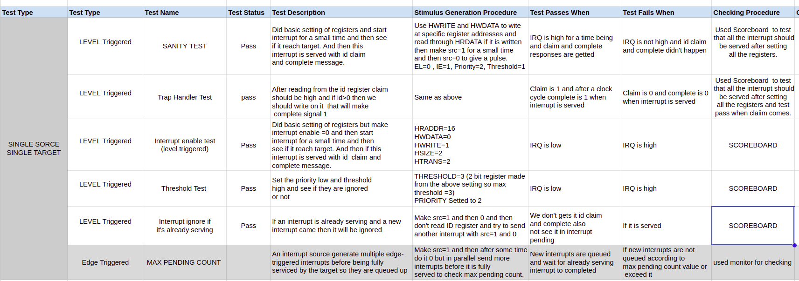
Test Plan
https://docs.google.com/spreadsheets/d/1W5Jq-S-Ax40a-GSh9IWnShphrQ-pMGm6yDFS9osVTvg/edit?pli=1#gid=1885784281

Slide 13
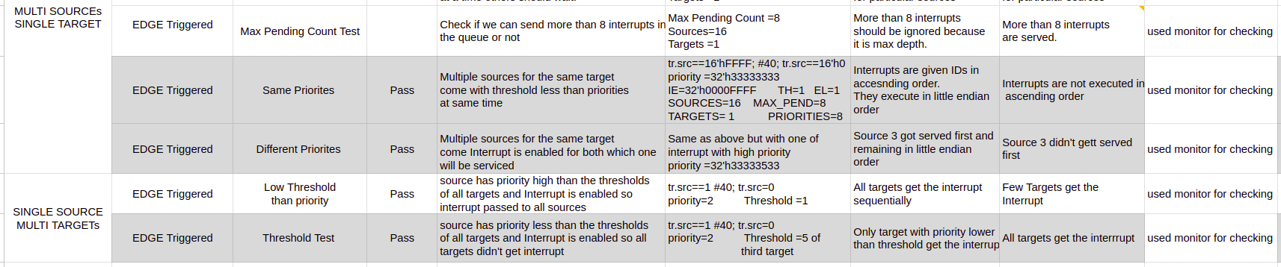
Test Plan
https://docs.google.com/spreadsheets/d/1W5Jq-S-Ax40a-GSh9IWnShphrQ-pMGm6yDFS9osVTvg/edit?pli=1#gid=1885784281

Slide 14
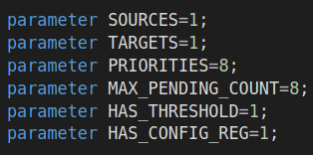
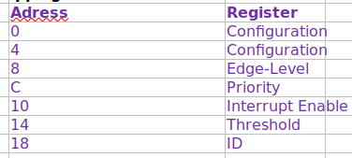
Demo
Sending Single interrupt one at a time from single source to single target. Configuration Settings:
Configuration:
Priority=2, Edge Triggered, Threshold=1, Interrupt Enable=1

Slide 15
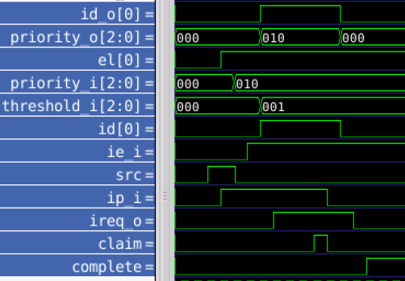
Demo
Sending Single interrupt one at a time from single source to single target

Slide 16
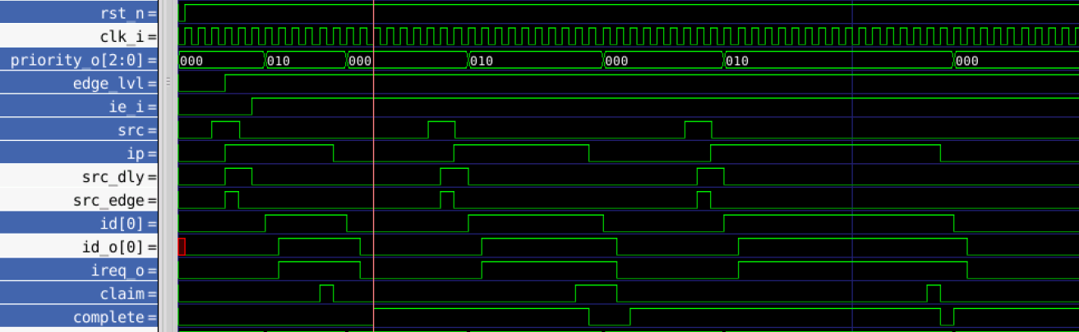
Demo
Sending Three interrupts one by one from single source

Slide 17
Demo
MAX Pending Count: An interrupt source may generate multiple edge-triggered interrupts before being fully serviced by the target. To support this the PLIC is able to queue these requests up to a user-defined limit per interrupt source. This limit is defined by the parameter MAX PENDING COUNT.
If the number of interrupts generated by a source exceeds the value of MAX PENDING COUNT,those additional interrupts are silently ignored.

Slide 18
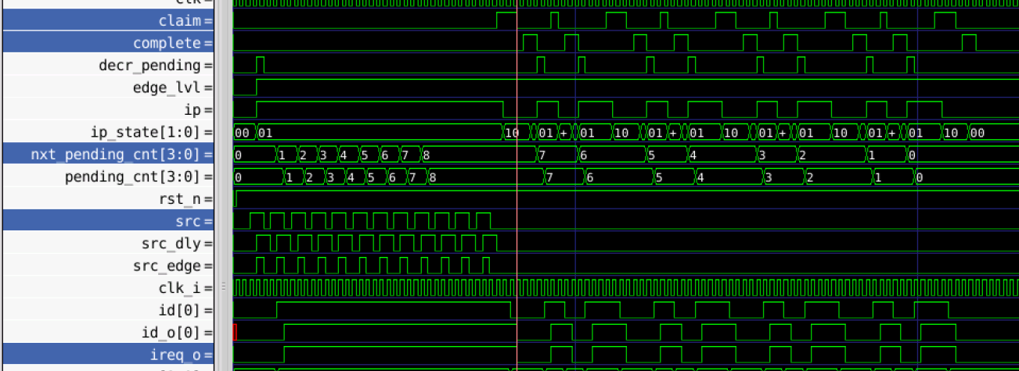
Demo
Edge Triggered Test: Sending 12 interrupts at a time before first interrupt is fully served and setting max pending counter to 8 and see if these all are served or ignored more than 8

Slide 19
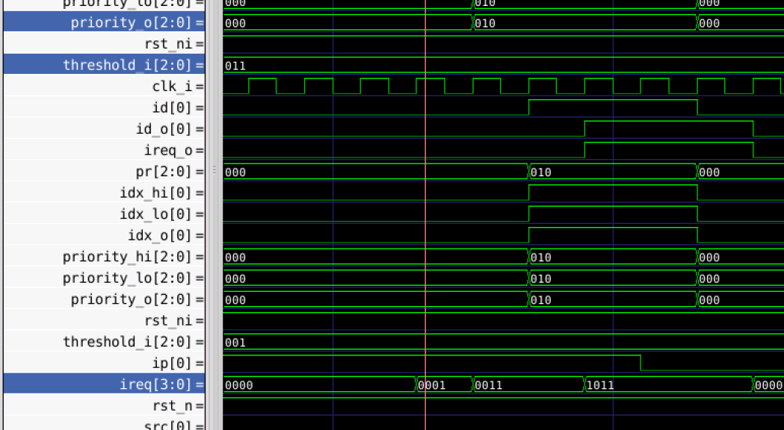
Demo
Single Source sending interrupts at a time to multiple targets
Setted one of the threshold to 3 and priority to 2

Slide 20
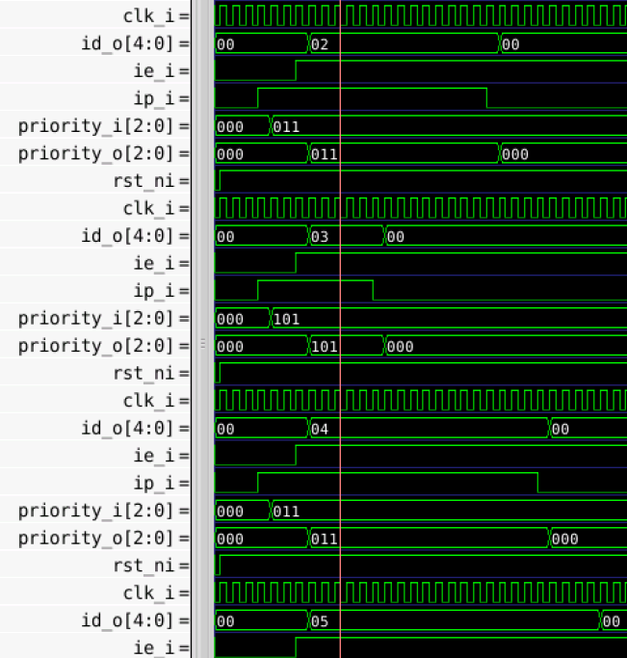

Demo
Priority Test: Sending multiple interrupts from multiple sources at a time and making third interrupt source priority high to see if it is served first or not.
Priority= 5 of source 3
All other sources have priority= 3
Threshold= 1

Slide 21
Thankyou. Questions?

